Slide 1
Driving Commercial Performance
in the Anesthesia Drug Market
BIA 810
Health Care Data & Analytics
Final Project
Team 5

Slide 2



Today’s Agenda
Time
Topic
Presenters
[0:00 – 1:00]
Kick off and Team Introductions
Aylin Wang
[1:00 – 3:30]
Business Problem
Aylin Wang
[3:30 – 10:00]
Analytical Findings
Kishan Girigowda
Havilah S
Om Rane
[10:00 – 14:30]
Strategic Recommendations
Om Rane
[14:30 – 19:30]
Future Opportunities
Raunak Raj
[19:30 – 20:00]
Conclusion
Aylin Wang
2

Slide 3








Meet the Team!
Aylin Wang
Om Rane
Havilah S
Professor:Sanjiv Koshal
Kishan Girigowda
Raunak Rajsewati
3

Slide 4
PROBLEM STATEMENT:
Despite launching Product 2 (Midoride) to cannibalize the declining Product 1 (Ketotrom), the intended internal cannibalization has failed, allowing competitor brands to capture the lost market share.
BUSINESS SOLUTION
Our team apply claims-based analytics to identify the drivers of failed cannibalization and redirect commercial efforts toward the patient segments, prescribers, and territories where Product 2 (Midoride) can most effectively compete.
BUSINESS IMPACT
This solution will
Enhance Product 2 (Midoride) market penetration in high-impact segments.
Reduce share loss from Product 3 (Fentirate) and Product 4 (Profativ).
Support Sales and Marketing through sharper targeting and resource prioritization.
Restore the intended cannibalization dynamic and stabilize portfolio performance.
Executive Summary
4

Slide 5
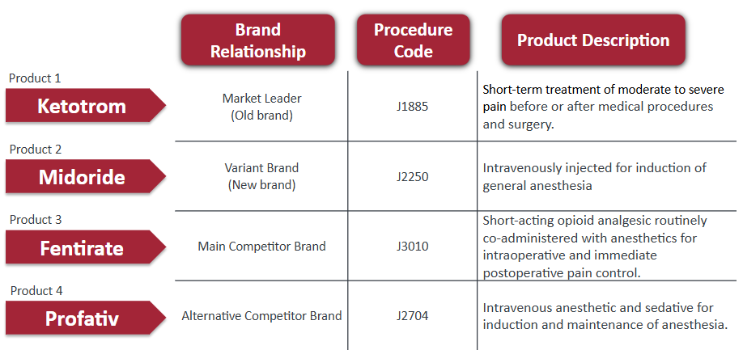
Business Problem
Background
The anesthesia drug market is growing due to increasing surgical volumes and an aging population.
Our company manages an anesthesia portfolio that includes a market-leading brand and a newly launched variant.
Prescribing decisions involve combinations of anesthetics and adjunctive drugs within the same anesthesia care pathway.
Problem Statement
Product 2 was launched to cannibalize the declining market share of Product 1 and protect portfolio performance.
The expected internal cannibalization is not occurring.
Competitor brands are capturing the market share, causing Product 2 to lose traction in a growing market.
Project Objectives
Identify the reason behind the condition.
Analyze patient, prescriber, and geographic factors contributing to Product 2’s market share erosion.
Develop data-driven recommendations to regain portfolio market share.
5

Slide 6
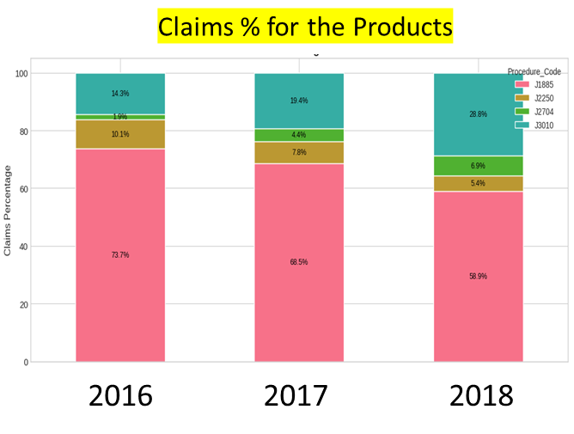
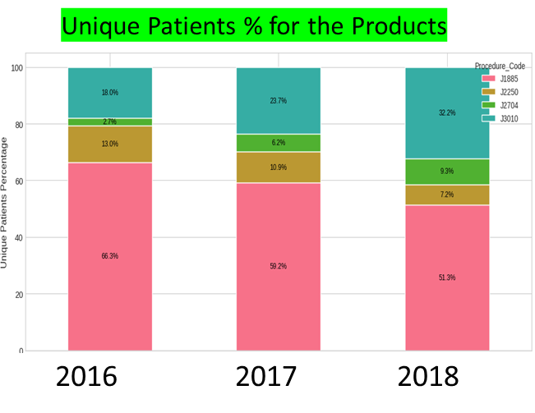
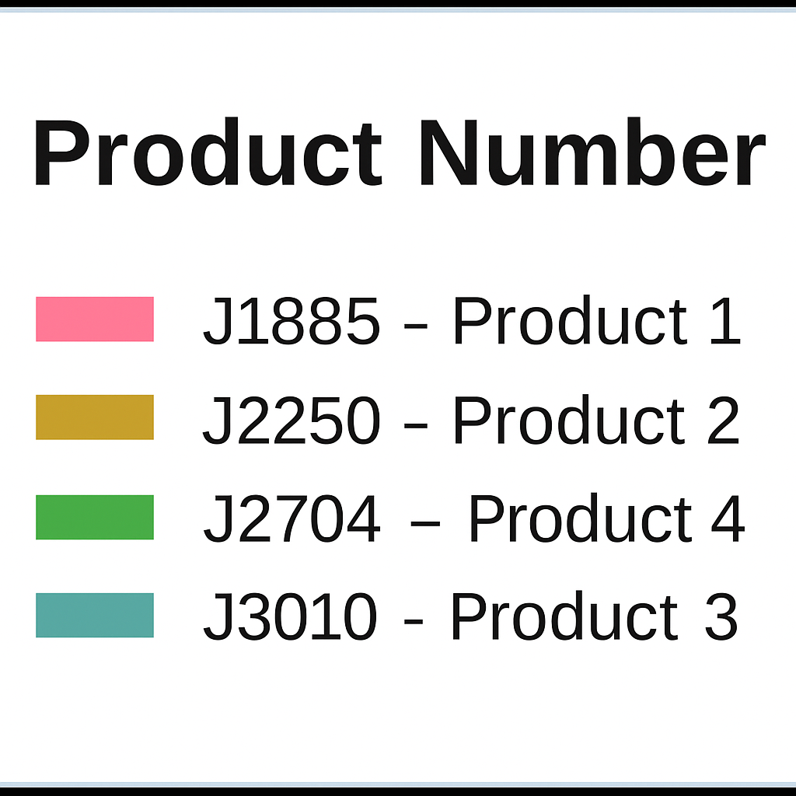
Analytical Findings- (A) Market Share Dynamics
J3010 (Product 3): Leading Market Disruption
J3010 (Product 3): Accelerating Growth
With remarkable 14.5 % growth, J3010 nearly doubled its market share, demonstrating strong differentiation, prescriber confidence, and effective commercial execution.
It demonstrates robust momentum with 14 % growth, capturing share from both J1885 and J2250 through superior adoption strategies and competitive advantages.
J2250 (Product 2): Struggles for Relevance
J2250 (Product 2): Severe Underperformance
J2250's precipitous drop to just 5.4% in 2018 signals a critical loss of market position, indicating weak differentiation and ineffective engagement strategies.
A 44% decline dropped J2250 from 12.97% to 7.20%, exposing critical gaps in competitive positioning and patient/provider engagement strategies.
Consistent declines in Product 2 and gains in Product 3 across claims and patients confirm a structural market shift.
6

Slide 7
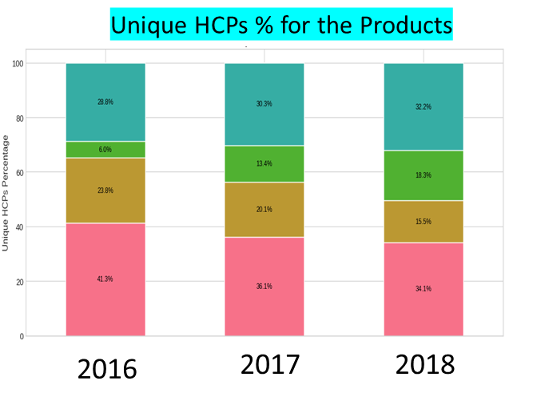
Analytical Findings- (A) Market Share Dynamics
Competitor brand: Prescriber Adoption Driver
Variant brand: Prescriber Base Erosion
J3010’s HCP share increased steadily to 32.16%, reflecting broad-based prescriber adoption and signaling strong clinical acceptance and positioning relative to incumbent therapies.
J2250 experienced a 35% decline in HCP share over two years, indicating significant loss of prescriber engagement and weak differentiation, making it the primary contributor to market share erosion.
HCP adoption is shifting away from Product 2 toward Product 3, indicating that changes in prescriber preference are the primary driver of market share erosion.
Across claims, patients, and prescribers, the market is structurally shifting from Product 2 toward Product 3, confirming a sustained reallocation rather than a temporary fluctuation.
7

Slide 8
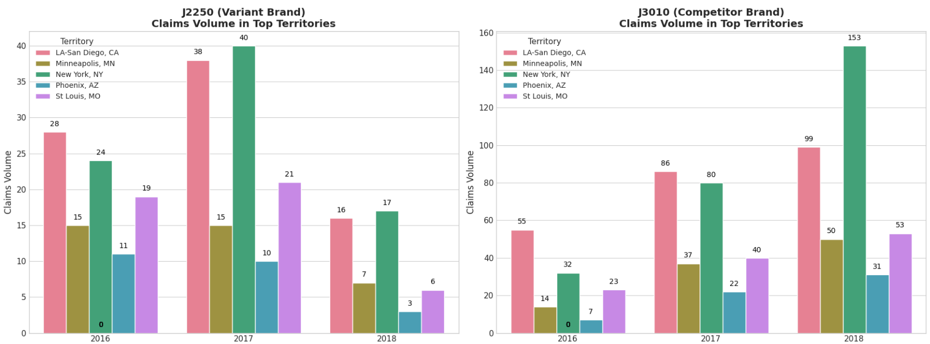
Analytical Findings- (B) Market and Territory Insights
Evidence of erosion: Product 2 decline is concentrated in specific territories.
Territory Insights
Top 5 territories show the largest YoY drop in Product 2 claims from 2017 to 2018.
These territories have large HCP populations and historically high claim volumes → high-impact “rescue zones.”
In the same territories, Product 3 (J3010) remains grows, suggesting share shift away from Product 2.
Territory Prioritization
New York & LA-San Diego: High-volume urban markets where J3010 decisively outperforms J2250, representing priority battlegrounds for competitive defense and offense.
Phoenix & Minneapolis: Smaller but volatile territories, suitable for targeted recovery pilots and differentiated engagement for J2250.
Conclusion: Market erosion for Product 2 is clustered in a few high-value territories. Focus on the HCPs in specific territories.
8

Slide 9
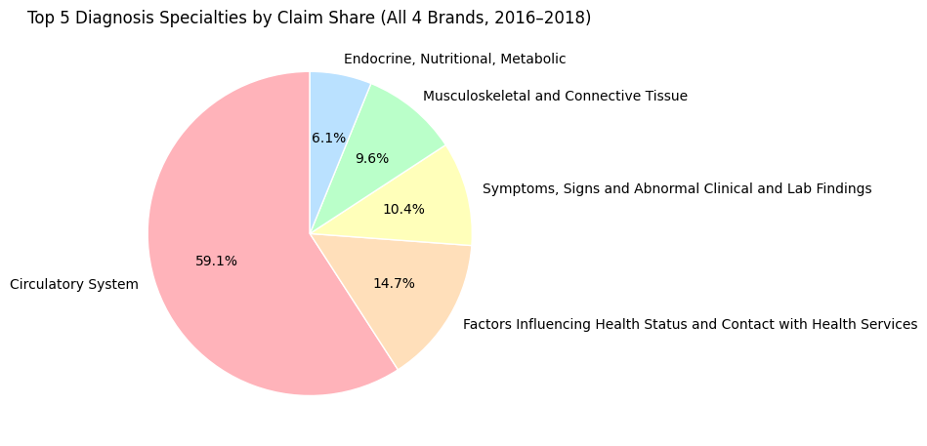
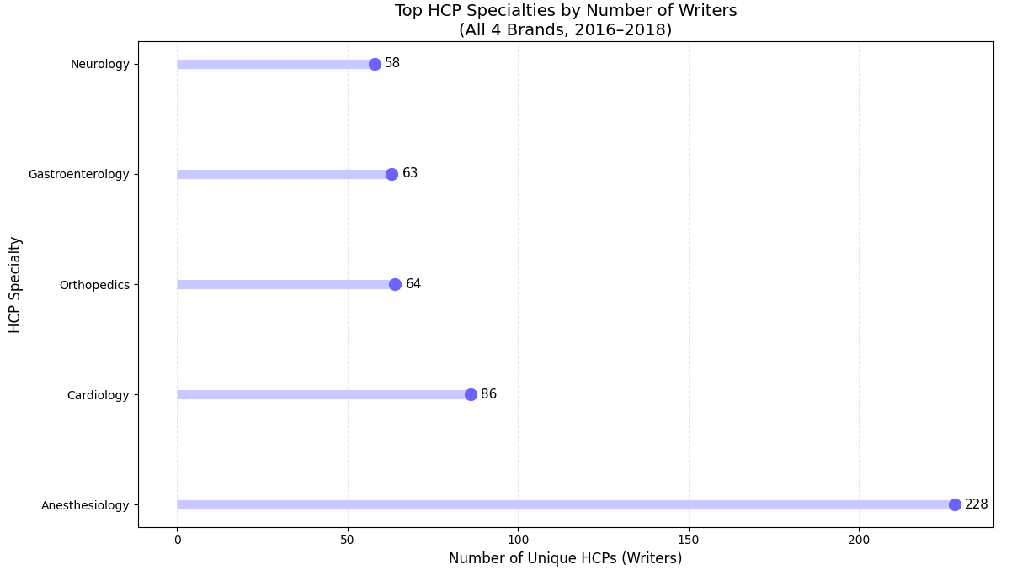
Analytical Findings- (C) Patient and HCP Insights
Core market insight: Older circulatory patients and their anesthesiologist/surgeon prescribers are the key battleground for Midoride.
Older patients (61+ years) account for the majority of patients and claims in the injectable anesthesia market.
Circulatory system diagnoses dominate claim volume among the top 5 diagnosis categories.
Anesthesiologists, cardiologists, and orthopedic surgeons are the main prescriber specialties driving claims.
9

Slide 10
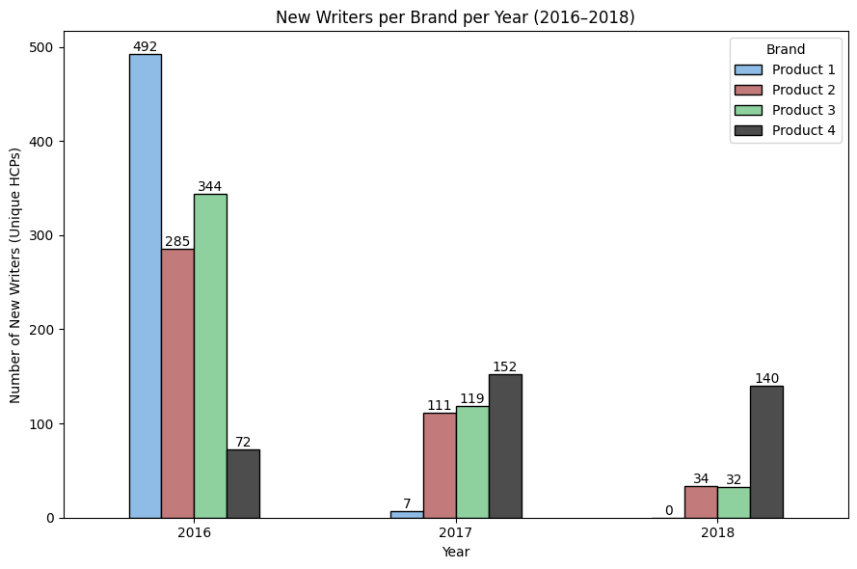
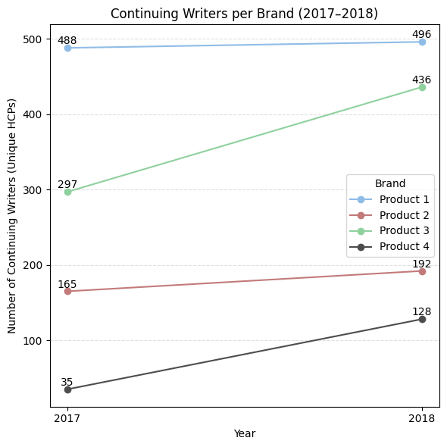

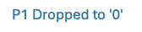
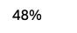
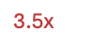
Analytical Findings- (D) Prescriber Dynamics
Most critical evidence: Product 2 is losing both writer acquisition and retention
In 2016, all brands gained many new writers, but Product 2(Mi) started from a lower baseline than Product 3(Fentanyl).
From 2017–2018, new writers decline most sharply for Product 2, while Product 3 and Product 4 keep attracting new prescribers.
Continuing writers for Product 3 grow steadily, but Product 2 has a smaller base and only modest growth, showing weak retention and depth.
Emerging competition: Product 4 is quickly capturing new writers, creating an additional competitive threat.
Conclusion: Product 2’s decline is fundamentally a writer problem – it is weak at both gaining first-time prescribers and keeping them.
10

Slide 11




Strategic Recommendations
Immediate Actions to Stabilize Market Share: The current market position demands swift, targeted interventions. Our three-pronged approach focuses resources where they'll deliver the fastest impact on prescription growth and market share recovery.
Territory Intervention
Co-pay & Payer Assistance
Deploy concentrated field force resources and enhanced promotional support to the top 5 underperforming territories. Real-time monitoring will track prescription velocity and market share gains weekly.
Launch enhanced patient support programs immediately to reduce out-of-pocket costs. Streamlined enrollment processes will accelerate uptake and remove financial barriers to therapy initiation.
Targeted Digital Promotions
Execute high-impact email campaigns and interactive webinars designed to re-engage lapsed prescribers. Personalized content will address specific clinical concerns and showcase new efficacy data.
11

Slide 12

Strategic Recommendations
Strategic Initiatives for Sustainable Growth: Beyond immediate stabilization, long-term market leadership requires fundamental shifts in brand positioning, HCP engagement, and patient-centric marketing strategies.
01
02
Brand Repositioning
HCP Specialty Engagement Programs
Align Product 2 with Product 1's established legacy of trust and clinical excellence. Unified branding across all sales and marketing collateral will create a powerful portfolio story that reinforces credibility.
Develop customized education initiatives and advisory boards for key specialty segments. These programs will deepen relationships with opinion leaders and provide valuable clinical insights to inform strategy.
03
Patient Segment Focus
Target messaging and educational materials to specific patient age groups showing highest growth potential. Tailored content will address unique needs and concerns of each demographic segment.
12

Slide 13


Future Opportunities – Beyond Current Data
What's Missing from Our Data Landscape?
Patient Journey Gaps
Promotional Correlation Void
Our current analytics lack critical visibility into adherence and persistence trends, including therapy drop-off patterns. We're missing crucial insights into drug-switching behaviors and the underlying reasons for discontinuation.
No direct linkage exists between marketing activities, including sales calls and digital campaigns, and resulting prescription behaviors.
Payer Intelligence Deficits
Demographic Blind Spots
Comprehensive formulary positioning details remain elusive, hampering our ability to optimize access strategies.
Limited data coverage for younger patient populations and privately insured segments creates significant gaps in our market understanding.
13

Slide 14

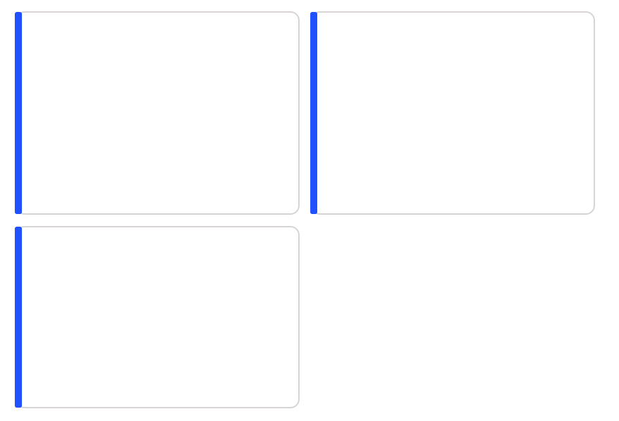
Future Opportunities – Beyond Current Data
How Additional Data Would Transform Our Strategy?
NPA/NSP Data
DDD Data
Analyze new-to-brand adoption rates and competitive switch patterns to identify conversion opportunities. Understanding which competitor products patients are switching from enables targeted messaging that addresses specific therapy gaps.
Track supply chain bottlenecks and uncover regional distribution trends that impact product availability. This intelligence allows proactive intervention before stock-outs affect prescription patterns and market share.
Calls & NPP Data
Establish direct correlations between promotional activities and prescription uptake patterns. Quantifying the ROI of sales calls and digital campaigns enables optimization of resource allocation and tactical execution.
14

Slide 15




Future Opportunities – Leveraging ML to Narrow the Gap
Advanced machine learning models will transform raw data into actionable intelligence, enabling precision targeting and optimized promotional strategies across territories and physician segments.
Promotional ROI Modeling
Predictive Targeting
Resource Optimization
Continuous Learning
Correlate call frequency, digital engagement, and campaign exposure with prescription velocity changes to identify highest-impact activities.
Forecast which promotional strategies will drive the greatest prescription lift for specific regions, specialties, and prescriber segments.
Dynamically allocate field force time and marketing budgets to maximize prescription growth potential across all territories.
Refine models continuously as new data flows in, ensuring strategies adapt to evolving market dynamics and competitive moves.
15

Slide 16

Conclusion: The Path Forward
Immediate Actions
Execute territory-specific interventions and specialty targeting to quickly address underperformance and seize growth opportunities.
Enhanced HCP Engagement
Intensify efforts to retain and engage healthcare providers through targeted educational programs and advisory board participation.
Demographic Focus
Prioritize marketing and sales strategies for the 61-70 age group and other segments demonstrating the highest growth potential.
Strategic Rebranding
Capitalize on Product 1's established market presence to boost Product 2's visibility and credibility with healthcare providers.
Data-Driven Decisions
Deploy machine learning models to optimize promotional strategies and improve prescription uptake in underperforming territories.
16

Slide 17


Q&A

Slide 18
Thank you
and Happy Holidays !

